Slide 1
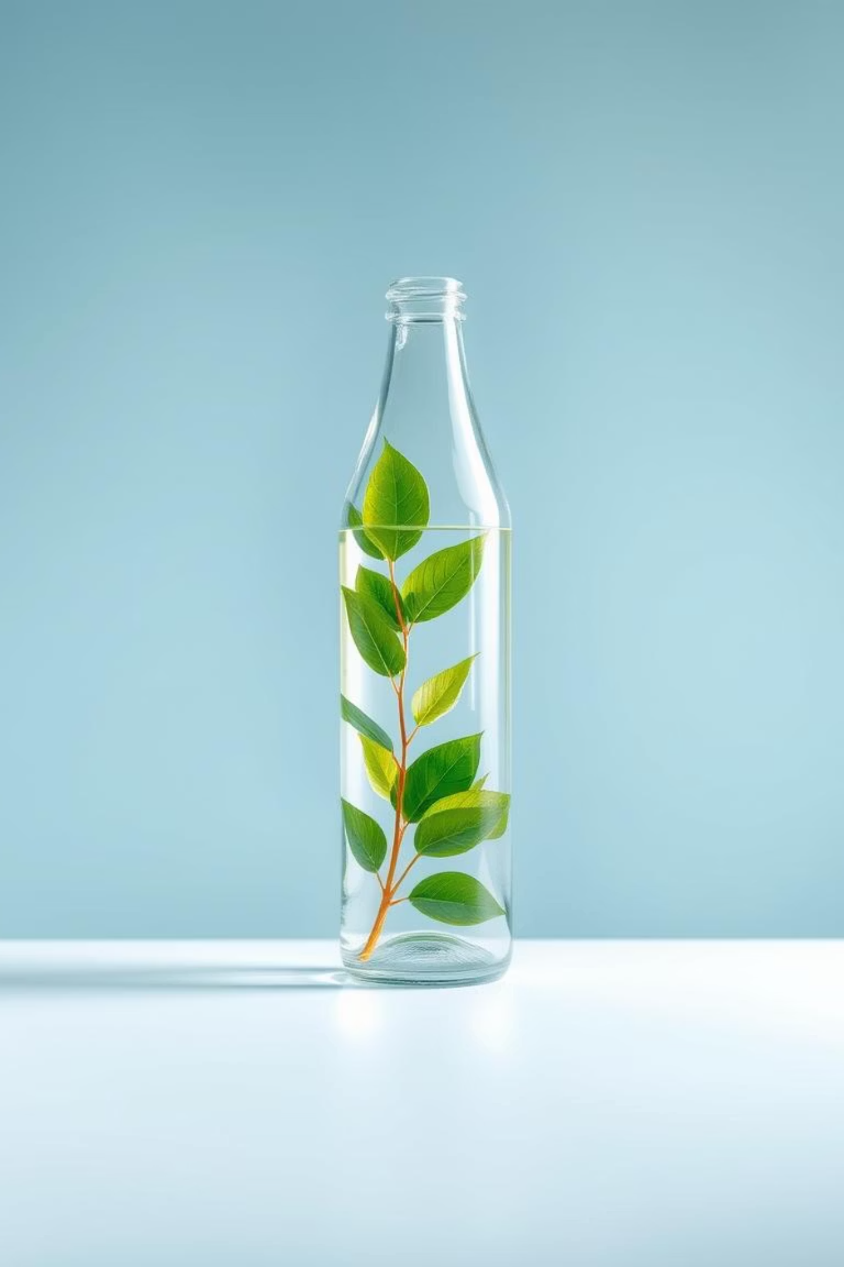

Botalsepaisa: Give Back. Get Back. Go Green.
Welcome to Botalsepaisa, India's innovative bottle return and reward system. Inspired by global successes, we're transforming plastic waste into a source of value, empowering communities, and fostering a greener future.
by Sritam Sarkar

Slide 2
The Plastic Predicament in India
India faces a monumental challenge with plastic waste. Annually, over 3.5 million tons of plastic waste are generated, with a significant portion uncollected and polluting our land and oceans. This crisis demands an urgent and scalable solution.
3.5M+
60%
80%
Tons of Plastic Waste Annually
Uncollected Waste
Landfill Bound

Slide 3
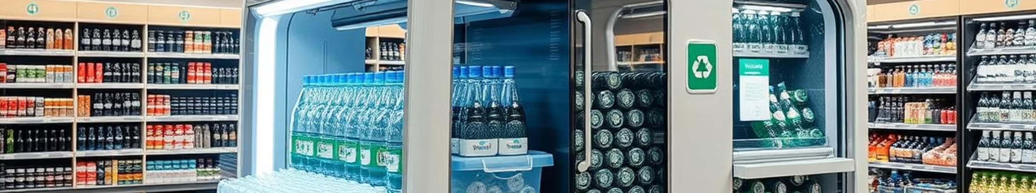
Inspired by Global Success: The Pfand Model
Our inspiration comes from Germany's highly effective Pfand system, a deposit-return scheme for beverage containers. This model has achieved remarkable success, with return rates exceeding 98%, significantly reducing litter and boosting recycling rates.
98%
2.5B+
Return Rate in Germany
Bottles Recycled Annually
Demonstrating the power of incentives.
A massive volume diverted from landfills.

Slide 4
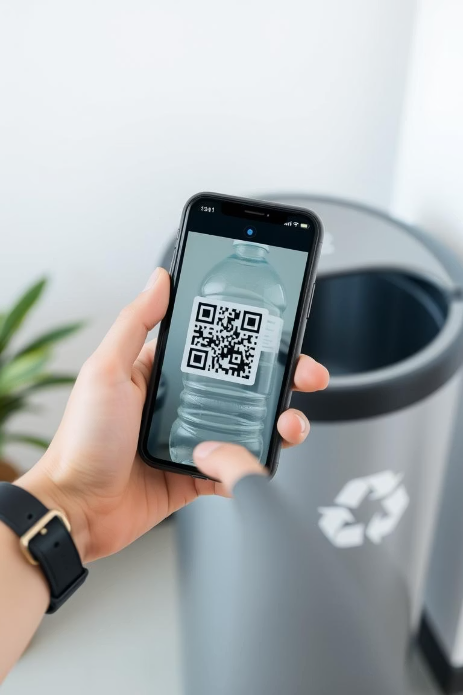



How Botalsepaisa Works: Simple & Rewarding
Scan QR Code
Identify and register your empty bottle.
Deposit Bottle
Drop it into a designated collection point.
Instant UPI Payout
Receive ₹1 directly to your UPI account.

Slide 5
Adapting for India: Localized Solutions
We've tailored the Pfand model to India's unique landscape. Our system integrates seamlessly with local kirana stores, leverages the widespread UPI payment system, and empowers ragpickers by providing a structured income source, creating a truly inclusive solution.
Kirana Network
UPI Integration
Ragpicker Empowerment
Local collection points for accessibility.
Instant, cashless rewards for users.
Formalizing and valuing their essential work.

Slide 6
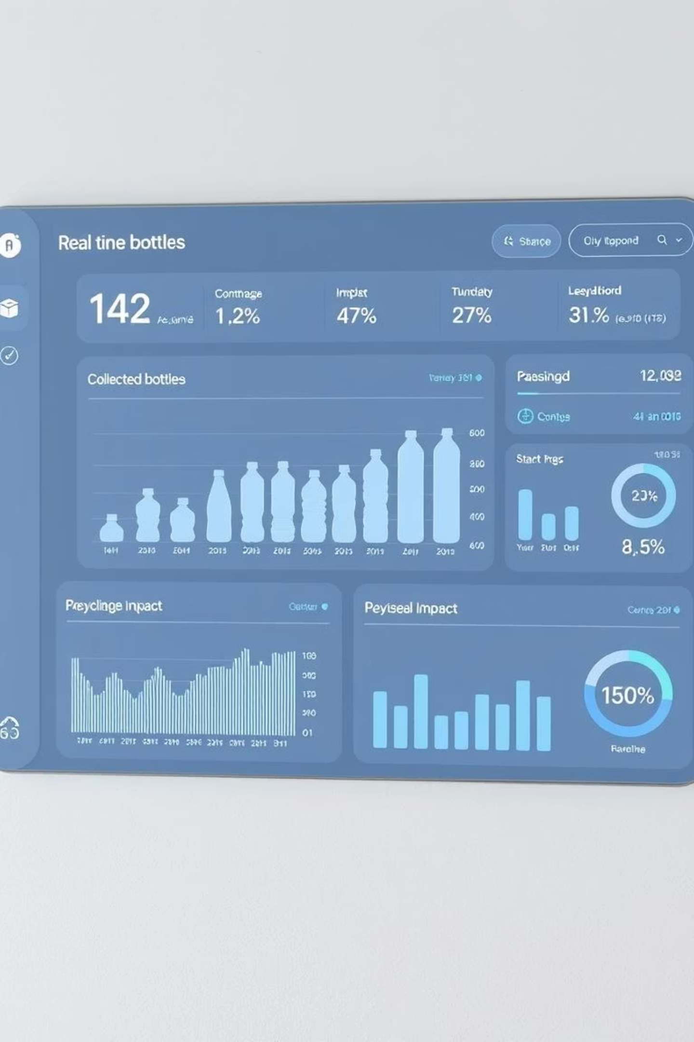



Smart Tech & Transparent Dashboards
Our robust technology platform ensures seamless operations. From QR scanning to instant payouts, every step is tracked. Our comprehensive dashboards provide real-time data on collection rates, environmental impact, and financial flows, ensuring transparency and accountability for all stakeholders.
User App
Easy scanning and reward tracking.
Real-time Analytics
Data-driven insights for optimization.
Cloud Integration
Scalable and secure platform.

Slide 7
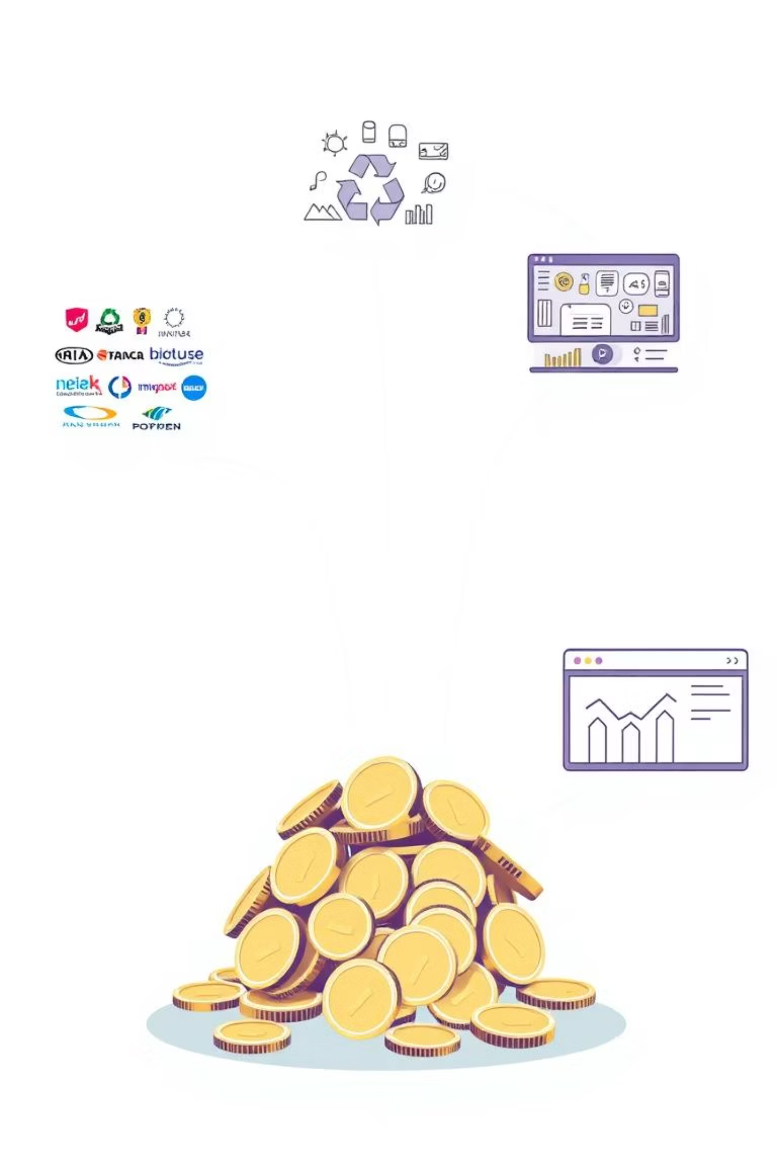
Our Sustainable Revenue Model
Botalsepaisa is built on a sustainable revenue model that benefits all participants. We generate revenue through Extended Producer Responsibility (EPR) credits, the resale of high-quality recycled PET materials, and brand fees for participating in our eco-system.
EPR Credits
Leveraging producer responsibility for funding.
Recycled Material Resale
Profiting from the valuable plastic collected.
Brand Participation Fees
Partnering with brands committed to sustainability.

Slide 8
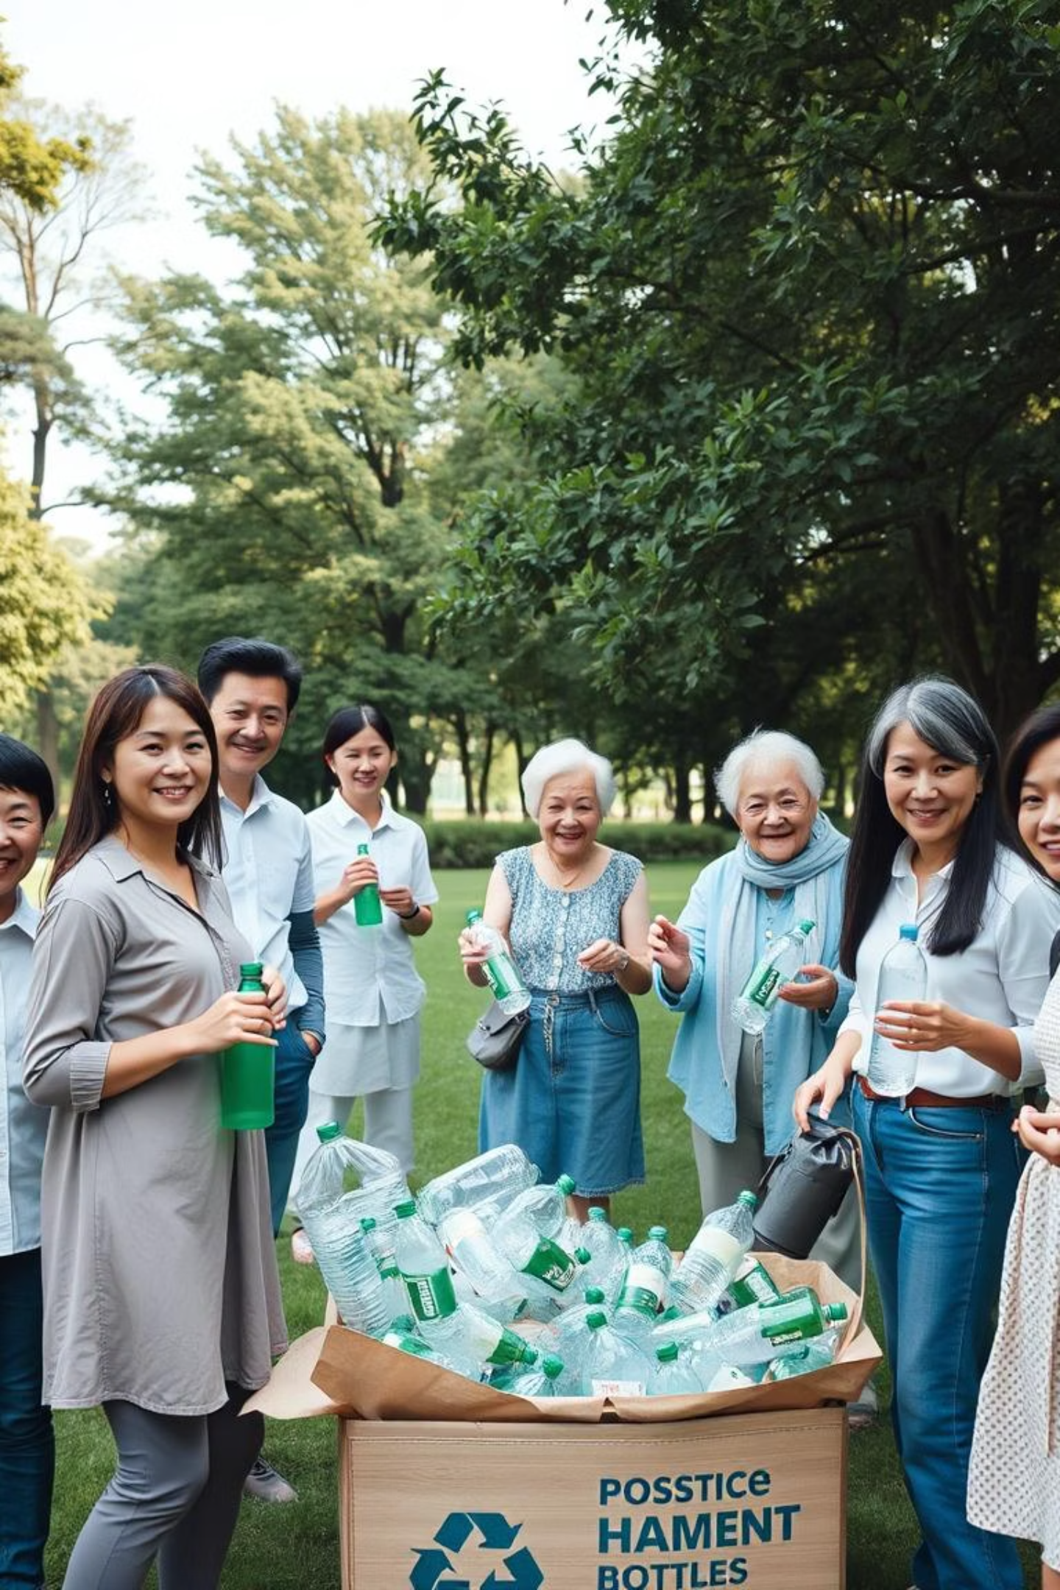


Impact & Call to Action
Botalsepaisa is more than just a recycling system; it's a movement towards a cleaner, more prosperous India. By participating, you contribute to environmental protection, economic empowerment, and a sustainable future for generations to come. Join us!

